Slide 1
Comp 4350 Software Engineering II Lecture 1
Dr. Shaowei Wang

Slide 2
About me (Shaowei Wang)
Research into data mining and software engineering
Machine learning for software engineering (e.g., API recommendation, code completion)
data analytics on software artifacts (e.g., Stack Overflow, GitHub, AppStore)
auto debugging (e.g., bug localization, fault localization)
Software security
Contact
shaowei.wang@umanitoba.ca
https://sites.google.com/view/mambalab

Slide 3
About the course
Course website
On UMLearn
Check regularly for announcements and updates
Lectures
60 mins lecture + 15mins Q&A
All slides will be posted on UMLearn after class

Slide 4
Contact & Office Hours
Dr. Shaowei Wang
Tuesday 9am-11am, EITC-E2-408
TAs:
Xu Yang <yangx4@myumanitoba.ca> Office hour: TBD
Shayan Daneshvar <daneshvs@myumanitoba.ca> Office hour: TBD
Cody Wallbridge <wallbric@myumanitoba.ca> Office hour: TBD

Slide 5

What are we doing here?

Slide 6
What are we doing here?
Cover topics:
DevOps
Configuration management
Continuous integration
Continuous deployment
AI for DevOps
Architecture
microservice
Software quality assurance
Advanced testing
Mutation testing
Load testing
Performance testing
…
Security analysis
Refactoring
Research in software engineering
Machine learning for software engineering
Data-driven software engineering
…

Slide 7




Recommend Books
Uploaded on UMLearm (Content->Recommended text books)

Slide 8
How will the course be evaluated?

Slide 9
Overall evaluation scheme
Letter | Percentage
A+ | [93,100]
A | [87,93)
B+ | [80,87)
B | [70,80)
C+ | [65,69)
C | [60,65)
D | [50,60)
F | [0,50)
Final exam: 40%
Project: 60%

Slide 10
What is the project about?

Slide 11
Project topic
A team of 4 or 5 students in the course to build a software system
Web application with front and back ends
At least have the same number of core functional features as team size
Meet the following non-functional requirement i.e., can response 20 users with a total of 200 requests per minute concurrently.
Your TA is your customer
You can use any programming language, framework, and tech stack.

Slide 12
Goal of project
Through the project
Obtain hand-on experience/skills of DevOps (tools like GitHub Action and Docker)
Obtain hand-on experience/skills of software quality assurance (e.g., load testing and security analysis)
Create a cool project

Slide 13
How will project be tracked and evaluated?
Team project (a total of 60%):
Project proposal + presentation (5%)
Progress tracking (20%, 4 sprints, each sprint 5%)
Technique sharing seminar (5%)
Final project presentation (10%)
Final project deliverable (20%)
Peer evaluation

Slide 14
Project proposal + presentation
Each team will submit a project proposal, which includes (template found on UMLearn)
project summary
core features
Technique or framework
user stories for core features
Present their proposed project in the class (10 mins)

Slide 15
Progress tracking
The entire project is due in 4 sprints.
Each sprint is 2-4 weeks.
From the 2nd sprint, each sprint needs concrete tasks finished, e.g., features implemented, testing, or bugs fixed, CI/CD pipeline implemented.

Slide 16
Sprint | Tentative Events
Sprint 1 | Form team and select liaisons (send members to TA) Propose project Set up GitHub environment Work on requirements elicitation with customer (i.e., TA), set up meeting with TA as earlier as possible. Work on the user stories for core features
Sprint 2 | System design Development Testing (regression testing) Continuous integration Working system and get feedback from TA
Sprint 3 | Development Testing (e.g., load testing) Continuous deployment Working system and get feedback from TA
Sprint 4 | Fix bugs Add additional features Security analysis Load testing Final Project Demo

Slide 17
Evaluation of each sprint
Let your TA try out your software and get feedback of the software from TA (customer).
From sprint 2, at the end of each spring, you should have a working system and detailed instruction for installation for TAs to evaluate.

Slide 18

Technique sharing seminar
Each team will be responsible for holding a seminar in the middle of the term. These presentation and discussion sessions will be used to share your learning with other teams, e.g., techniques, frameworks

Slide 19
Final project presentation
Introduce your project
Live demo
core features
Techniques aspect
Lessons learnt from the project
…
We will invite all other teams to evaluate

Slide 20
Final deliverable
Documentation:
Requirements specification (user stories)
Design (e.g., class diagram)
User manual
Testing report
Security scanning report
…
Source code:
Product code
Test cases
CI/CD scripts
Docker image
…
*Found more in release template (UMLearn -> Content -> Course project)

Slide 21
Peer evaluation
Your individual project mark will be assigned by starting with project mark and then weighting it based on your contribution to the work of the team as reported by your fellow team members.
The contribution from team members M1 to M4 are 30%,30%,20%,20%, the project mark is 50. The final project grade for M1 to M4 are 50*30/25 = 60, 60, 50*20/25 = 40, 40

Slide 22
Using GitHub
Manage everything on GitHub.
Other than the code and necessary docs, all the discussion or meeting minutes need to be recorded on GitHub.
Discussion offline or on other platform needs to be documented on GitHub.
Code review is needed.
Someone else in your team need to read your code before committing after passing test cases.
Everything needs to be referenced.
Use GitHub to track issues.
Notes:
Show an example: https://github.com/n2chao/SOEN341
How many have used github before?

Slide 23
Managing your project
Version control everything on GitHub.
Automate everything with Devops pipeline

Slide 24
First thing to do!
Build the team.
Team leader needs to be confirmed in the first week.
If you do not have a team, leave comments in the google doc.
Please fill your team information here
https://docs.google.com/spreadsheets/d/1ewp5bUNU8EbpPAQqRLjMIKLyGNiLejSgUvC55txSoIA/edit?usp=sharing

Slide 25
Final test (40%)
There will be a final test that will cover course material from class.
Open book.
The time and location will be announced by the Student Records Office.

Slide 26
What do I need to succeed?
Take the test seriously
Participate class
This course is NOT just for programming! Learn and follow the software development and delivery process
Work as a team.
Be fair and supportive to your team members
Notes:
Be fair and supportive to your colleagues

Slide 27
Policy
Late submission. Students (student groups) can turn in their assignments and laboratory deliverables up to 2 calendar dates late. The penalty for lateness is that, for being late by each calendar date, a 10% of the actually obtained grade will be deducted.
Re-grading. Students (student groups) have up to 7 days from the time the graded assignment/test or laboratory deliverable is available to request a re-grading, if there is a disagreement with a grade. Weekends and holidays count when calculating re-grading request days. No re-grading will be done after this period. Re-grading requests shall be made to the instructor directly.
Generative Artificial Intelligence (genAI): Students may not use artificial intelligence tools for taking tests. However, Students may use artificial intelligence tools, including generative AI, in this course as learning aids or to gather information from across sources and assimilating it for understanding. If genAI was used, students must submit, as an appendix with their assignments, any content produced by an artificial intelligence tool, and the prompt used to generate the content.
E.g., generate code using ChatGPT, put the setting of ChatGPT, and prompt in the comments.

Slide 28
Introduction to Software Engineering

Slide 29

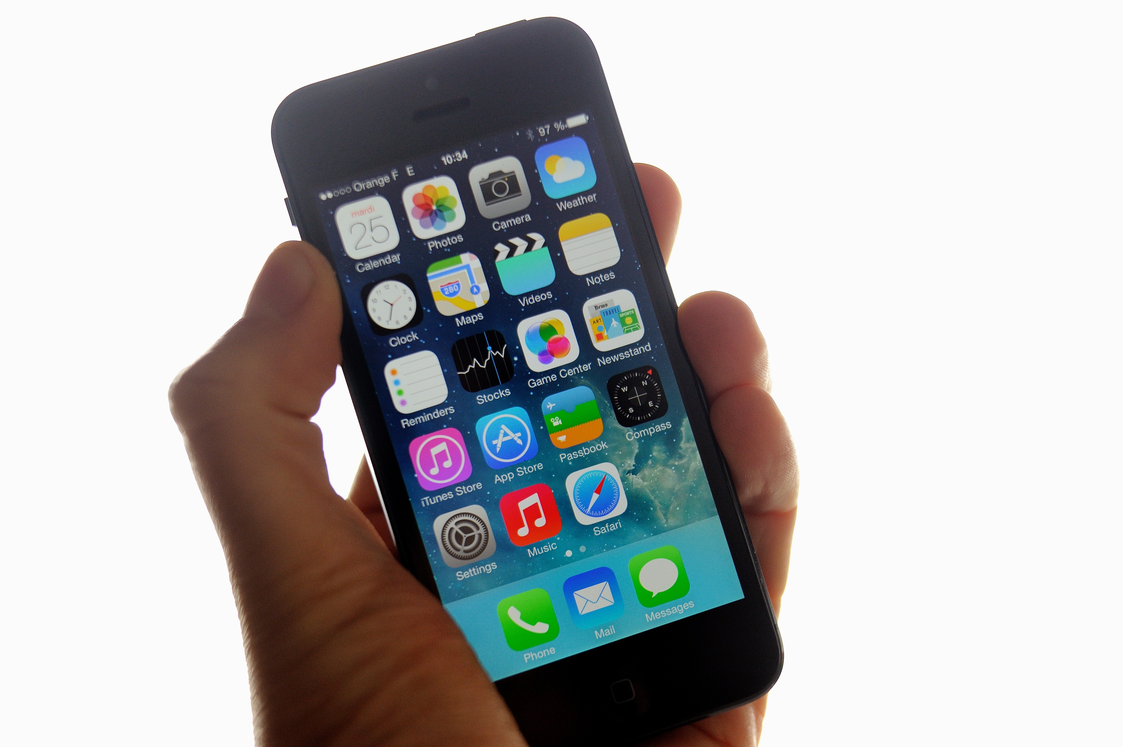


Software is everywhere!
Notes:
The world runs on software!
Obviously, it’s on our laptops
Operating systems, desktop applications, web browsers
Apps: Navigation apps!
Video games!
Software also runs our main infrastructure:
Financial applications: Banking software, Stock exchanges, trading software (power to bankrupt nations!)
Safety-critical systems: Software keeps our planes in the air, our trains from crashing, and even our hearts beating

Slide 30


Slide 31
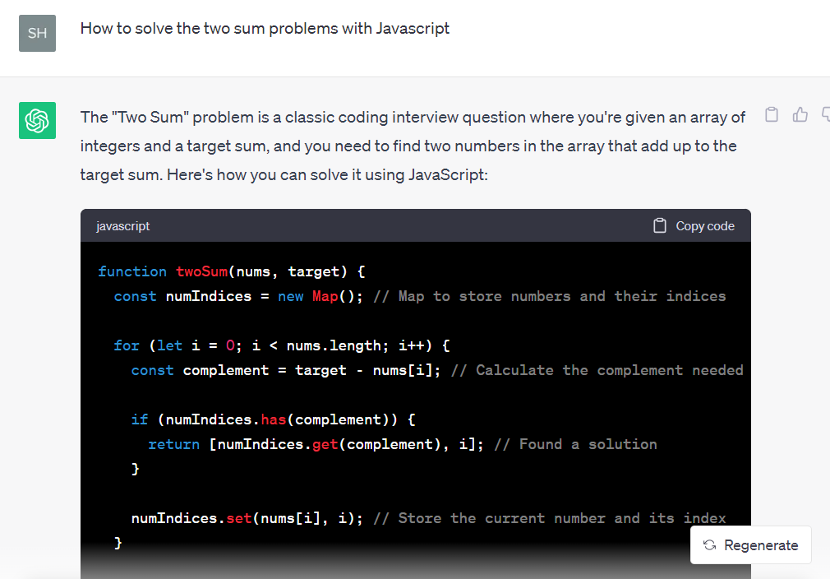
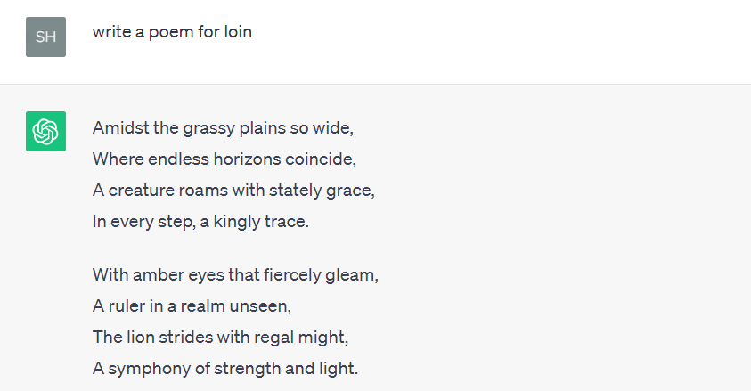
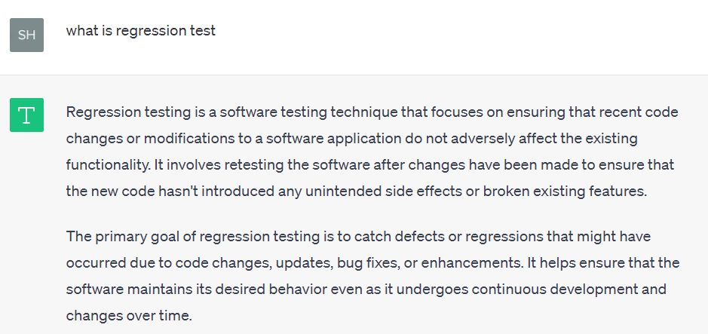
Generative AI
Write code
Write story/poem
Explain concept

Slide 32
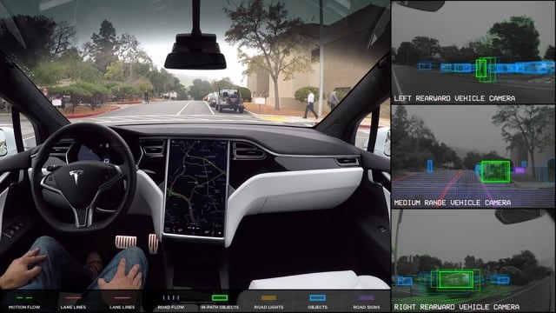

Slide 33
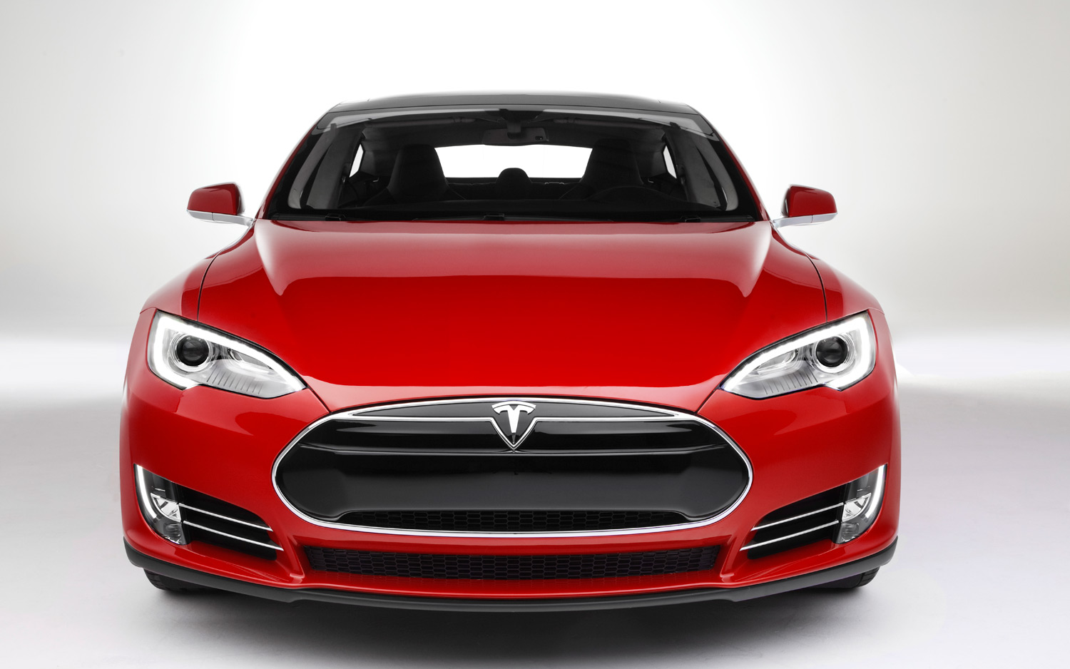
How many lines of code?

Slide 34
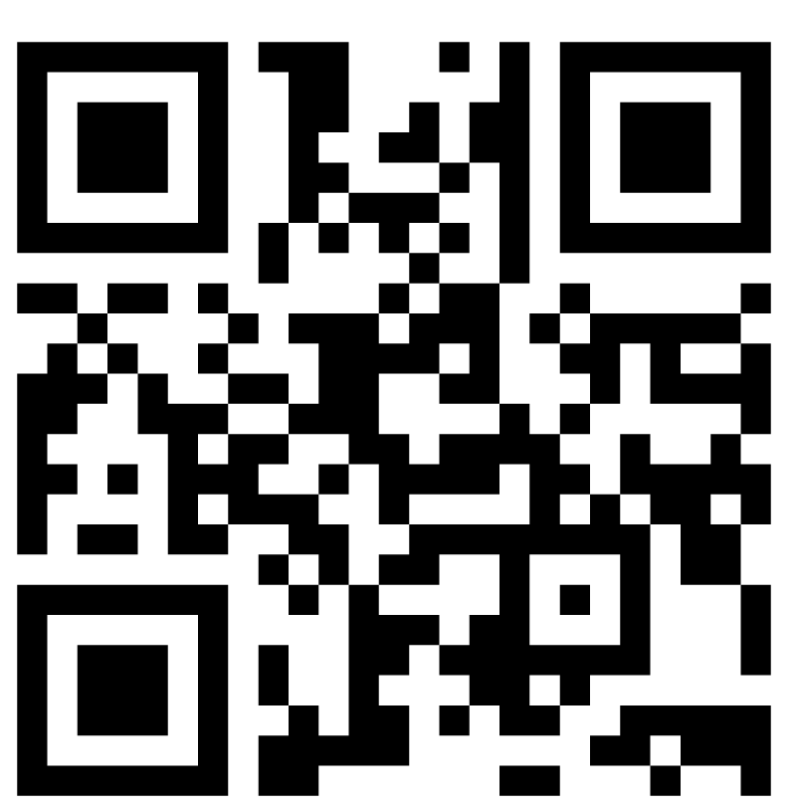
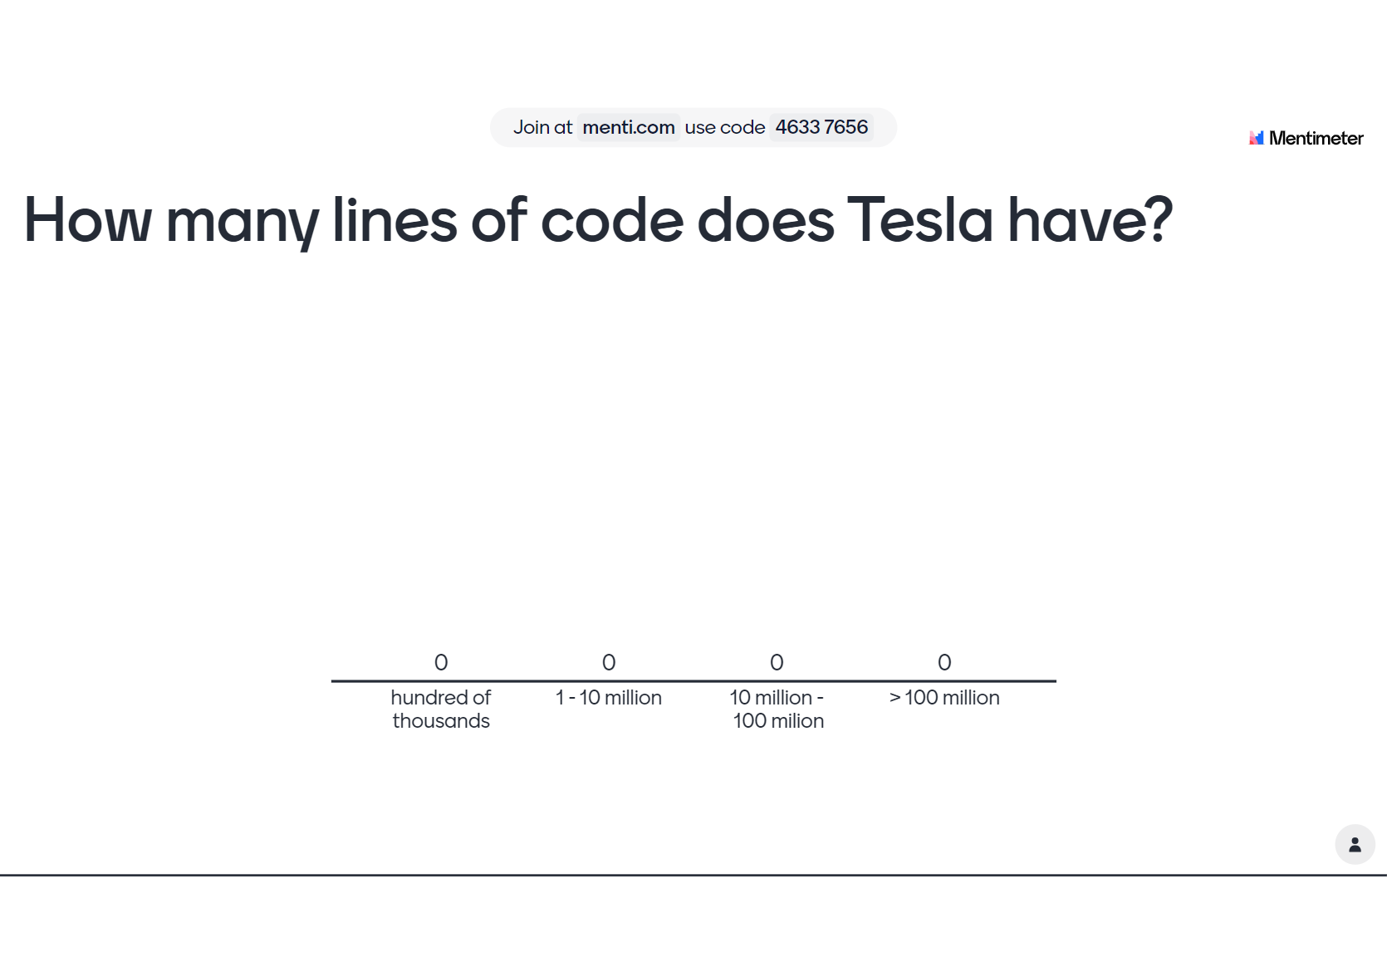

Slide 35
More than 100 Million lines of code!

Slide 36
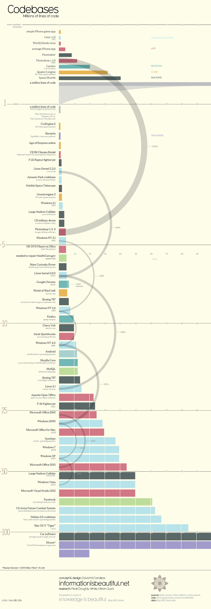
Notes:
How big is the biggest system that you’ve written?
Let’s look at the scale of some software systems out there now

Slide 39
No natural limits to the potential of software, .e.g, lack of physical constraints, software systems can quickly become extremely big and complex.
Make it difficult to understand, and expensive to change.
Notes:
This simplifies software engineering, as there are no natural limits to the potential of software. However, because of the lack of physical constraints, software systems can quickly become extremely complex, difficult to understand, and expensive to change.

Slide 40
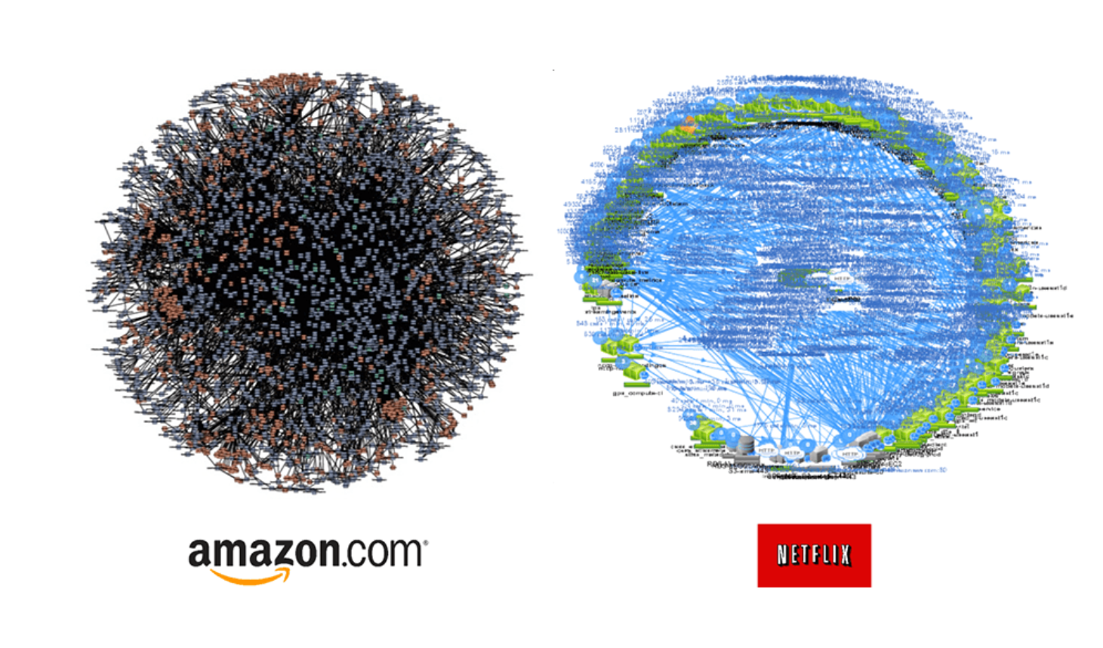
What is this?
Notes:
Micro services for amazon and netflex

Slide 41
“Software Crisis”
Projects running over-budget
Projects running over-time
Software was very inefficient
Software was of low quality
Software often did not meet requirements
Projects were unmanageable and the code was difficult to maintain
Software was never delivered
Therefore, Software Engineering is engineering principles to build software systematically, rigorously, measurably, on time, on budget, and within specification.
Notes:
Extreme complex software system also brings crisis and challenges.

Slide 42
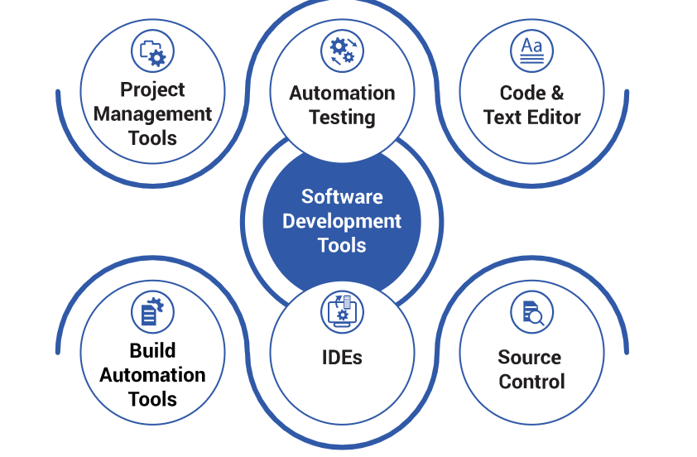
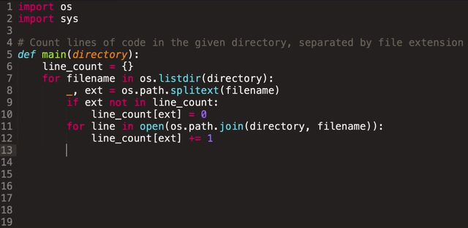
Software engineering
All aspects of software production
Not just technical process of development, also project management and the development of tools, methods etc. to support software production.
Notes:
SE is all about people!

Slide 43

Main software engineering activities
Specification
Development
Validation
Evolution

Slide 44
Software Process Phases
There are many different software processes, but they all share the same basic elements.
The difference is in how these elements are organized.
real-time software in an aircraft has to be completely specified (i.e., Specification) before development (i.e., Development) begins - waterfall
mobile apps, which require short release circle, the specification and the program are usually developed together – agile

Slide 45
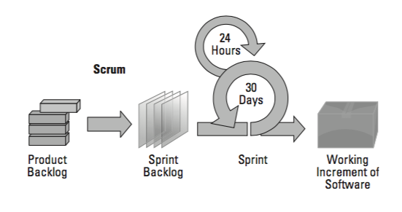
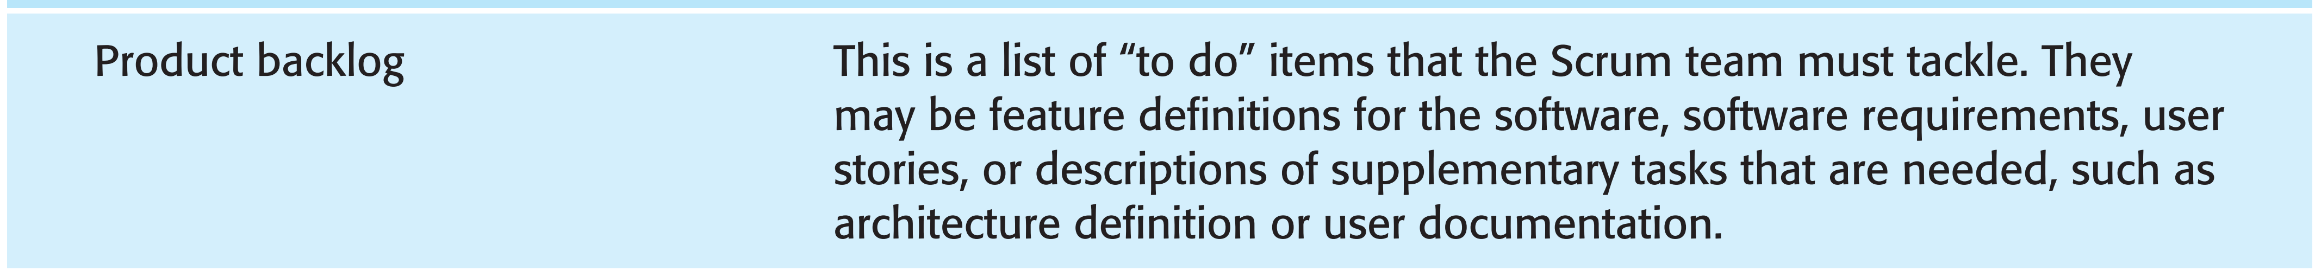
Overview of Scrum
Scrum is an agile method that focuses on managing iterative development that

Slide 46
Software engineering fundamentals (I)
Some fundamental principles apply to all types of software system, irrespective of the development techniques used:
Systems should be developed using a managed and understood development process. Of course, different processes are used for different types of software.
Reliability (e.g., time of running without bugs) and performance (e.g., query response time) are important for all types of system.

Slide 47
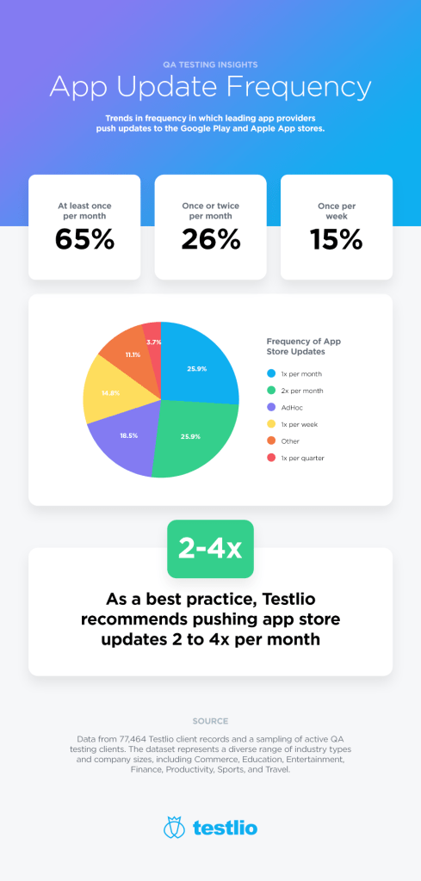

Rapid update of Mobile apps
https://testlio.com/blog/how-often-should-you-update-your-mobile-app/
Notes:
For instance, mobile apps are updated rapidly

Slide 48

How to reduce the risk of introducing new bugs when making changes to the software?

Slide 49
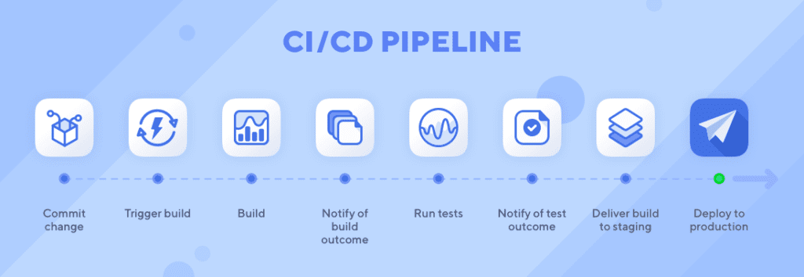

Slide 50
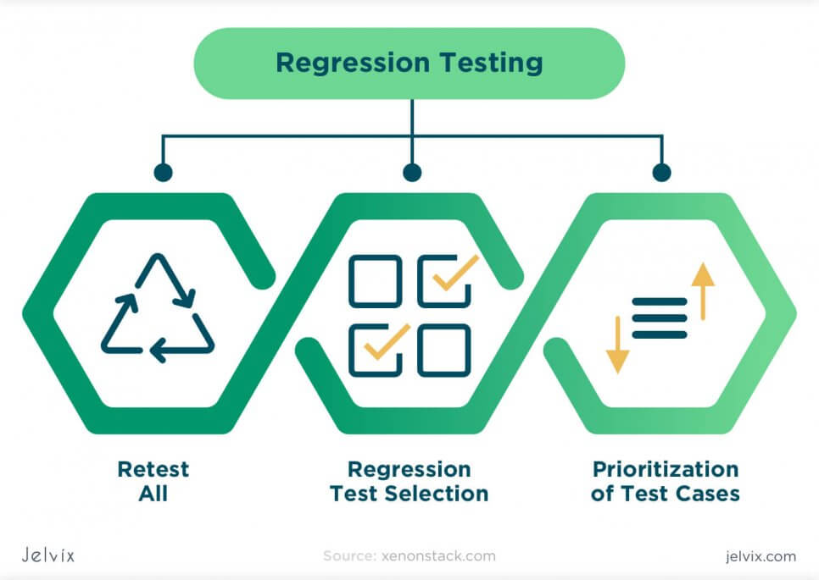

Slide 51
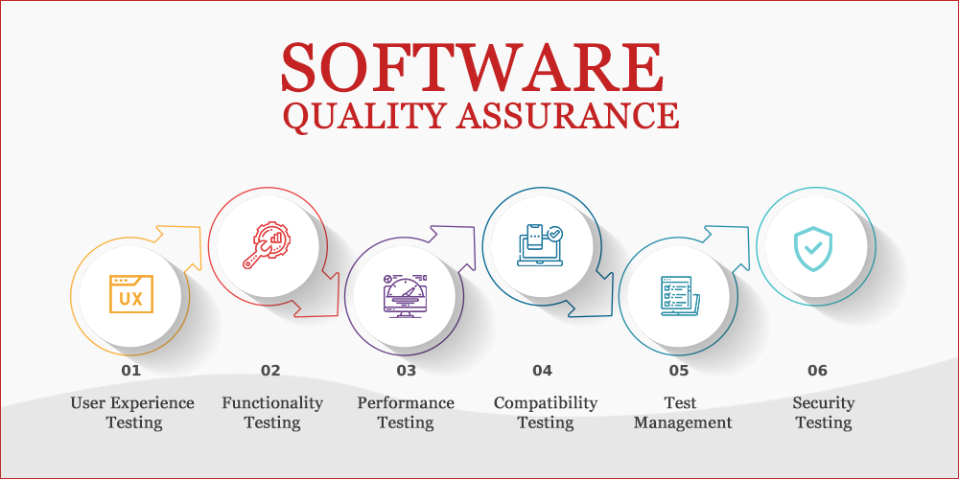
Software quality assurance
Notes:
We will introduce more in the following lectures.

Slide 52
Actions
Build a team!
Read project description and requirements @UMLearn -> Content -> Course Project -> Project description and requirements
Find textbook @UMLearn -> Content -> textbook

